Slide 1
THIS IS AN INTRODUCTION
To introduce myself

Slide 2

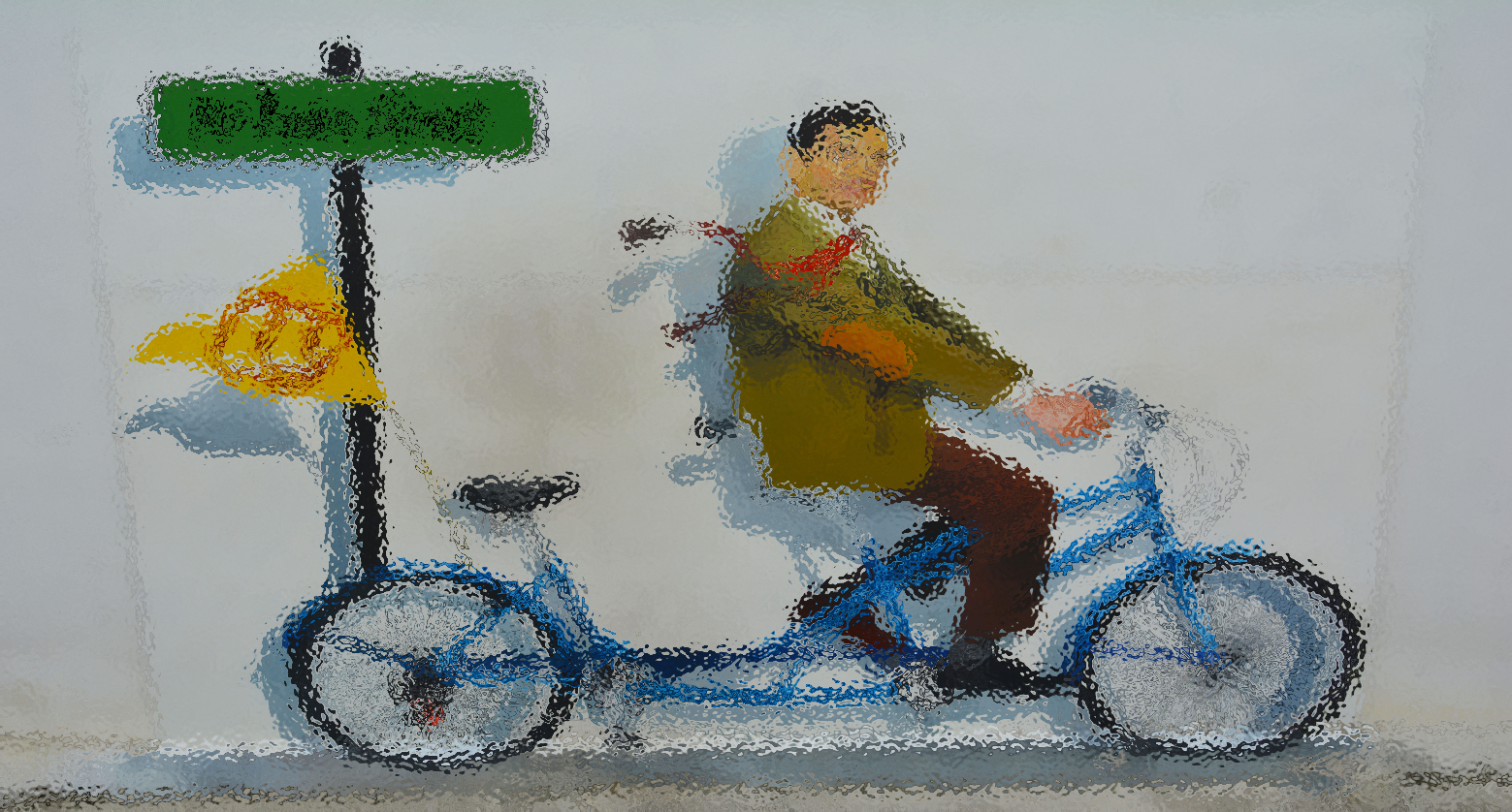
About Myself
My name is Hong Cai , My major is Computer Science and Technology . The reason why I choose to learn computer . May be I like surf the Internet , or I am interested in programming. Actually , I don’t know exactly . But I believe I will fall in love with computers in the future .

Slide 3
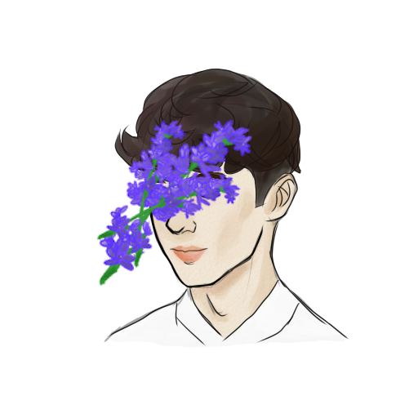
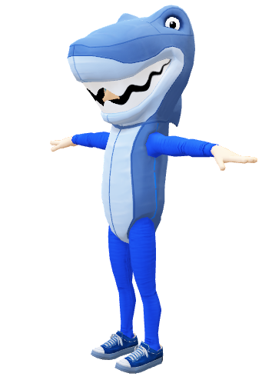
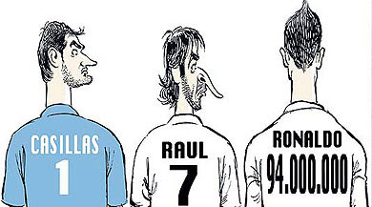
About Hobby
I have a lot of hobbies . Like listening to music , drawing , watching football games etc.

Slide 4
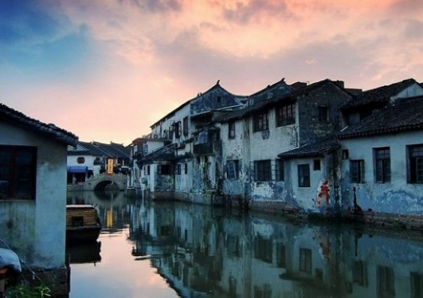
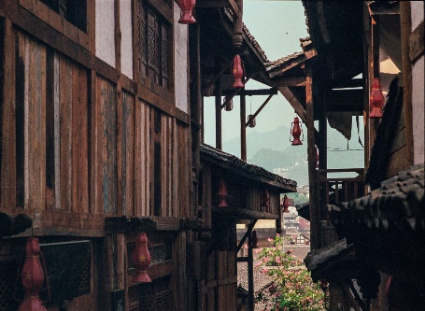
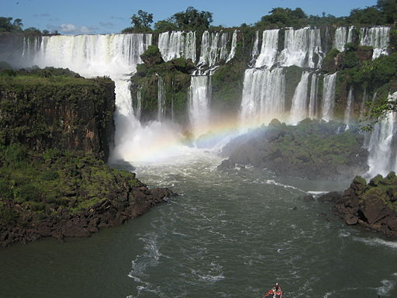
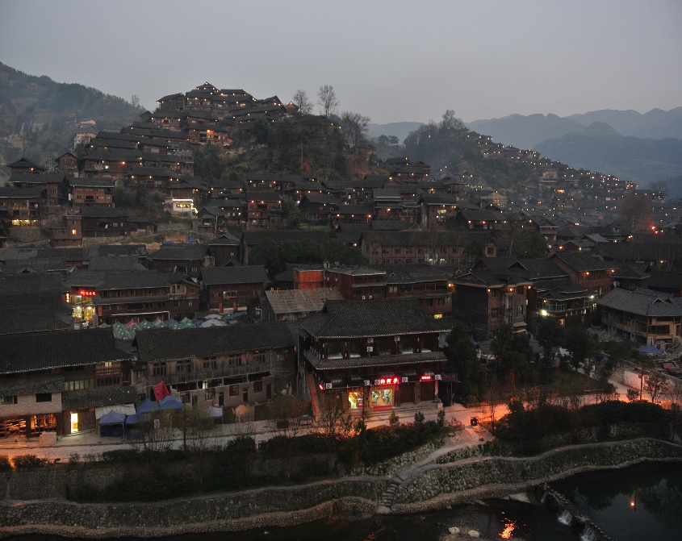
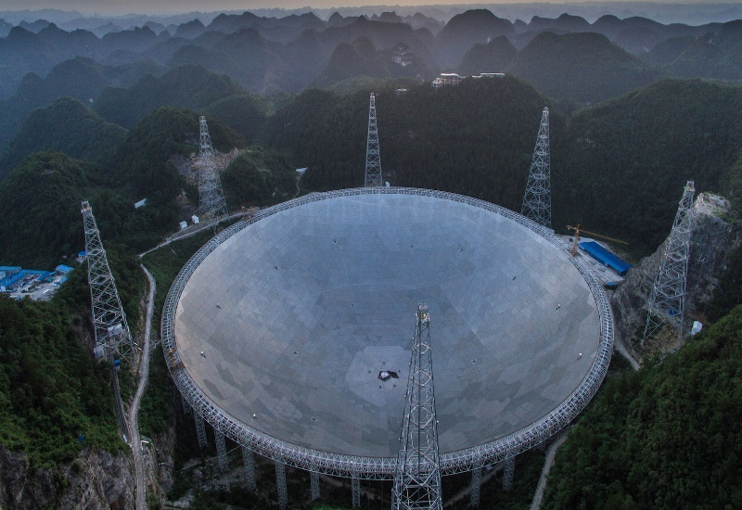
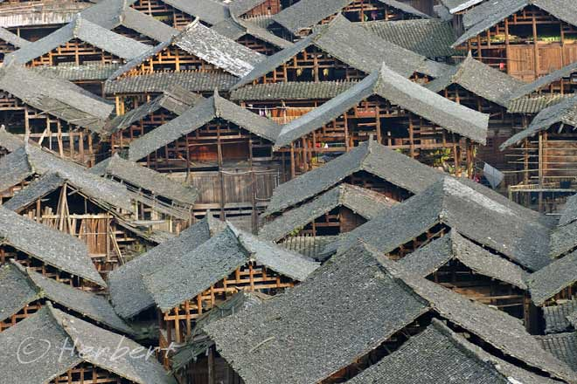
About Hometown
My hometown is in Guizhou . May be most people don’t know Guizhou . But you must know the most famous liquor , Maotai . Besides wine , There are many interesting places . Such as Huangguoshu waterfalls , China’s Eye of Heaven and Xijiang miao village .
This Photo by Unknown Author is licensed under CC BY

Slide 5
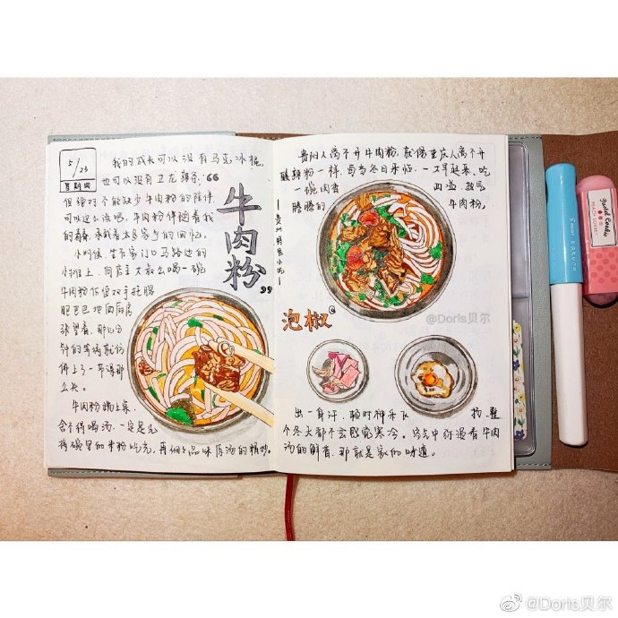
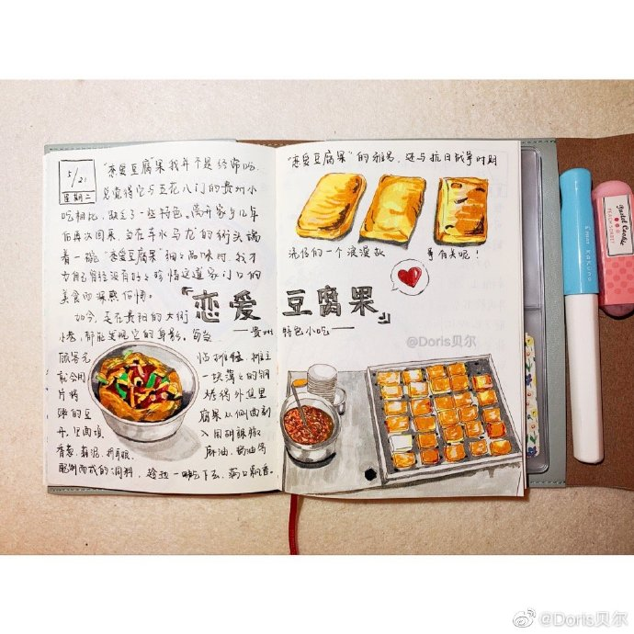
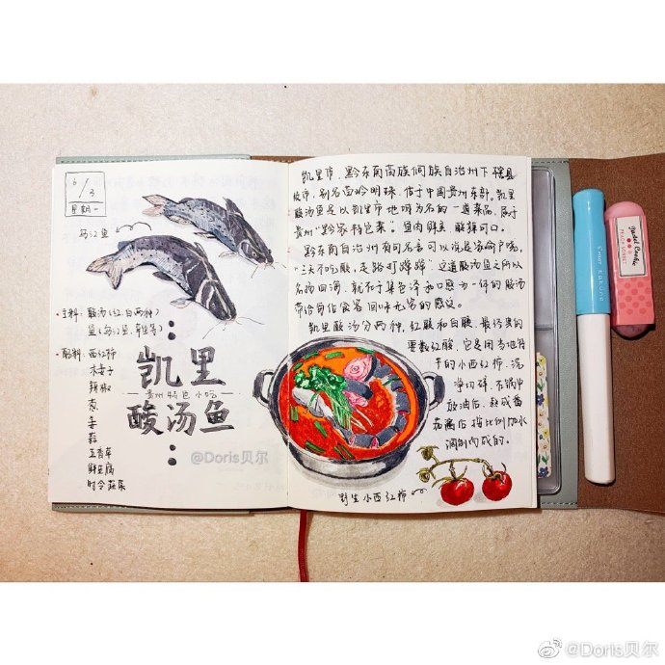
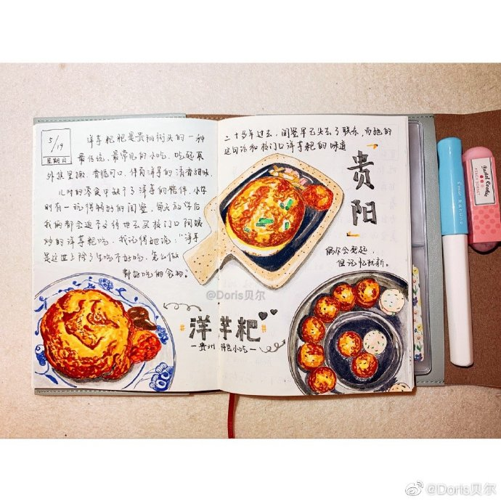
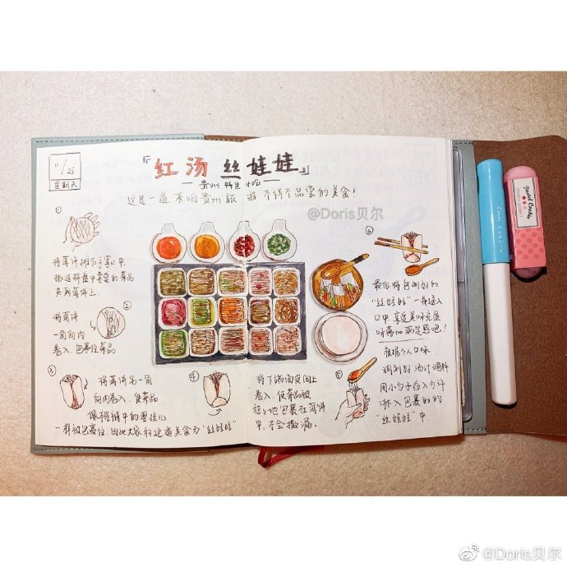
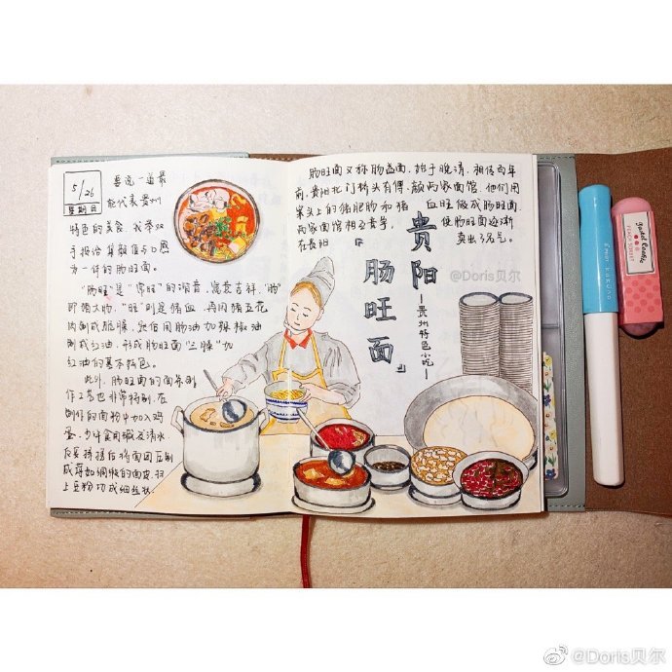
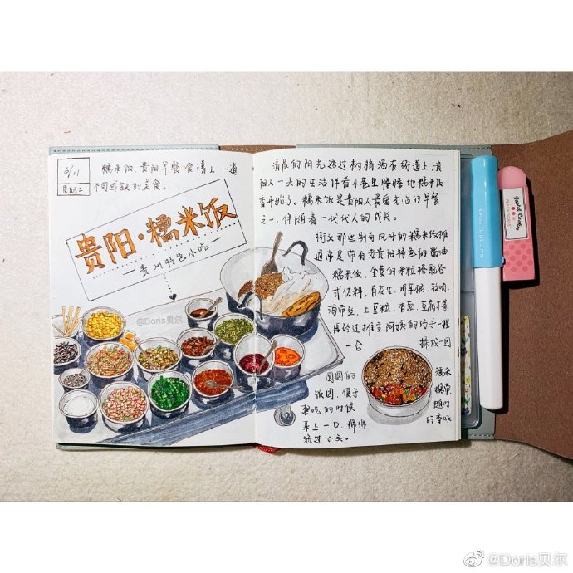
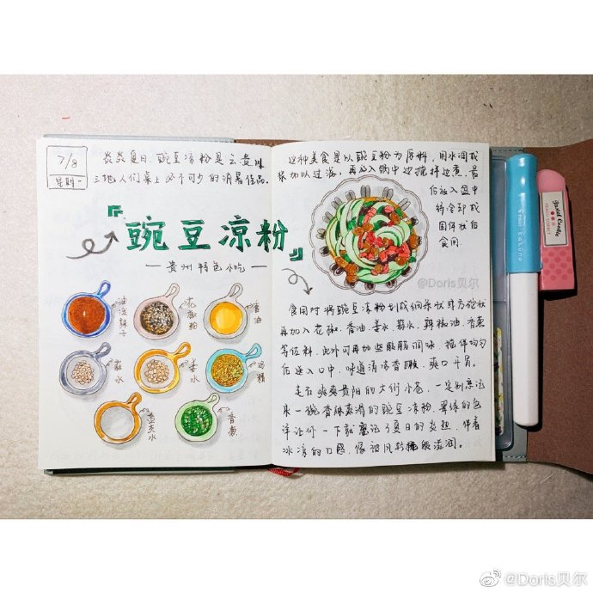
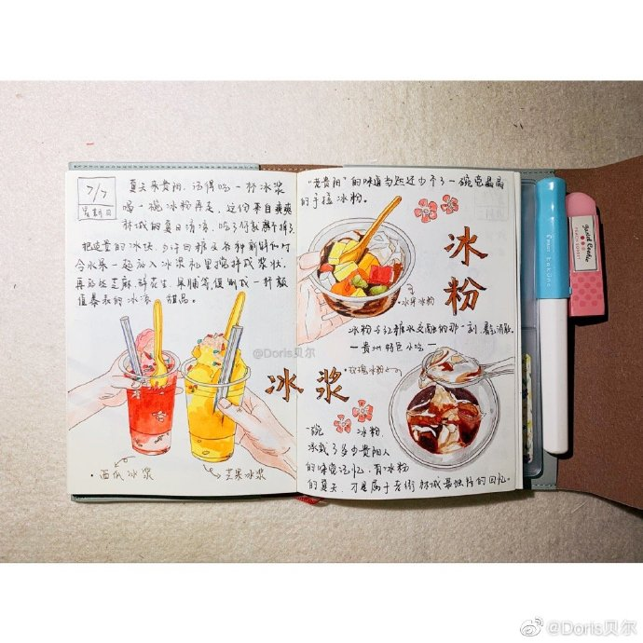
What’s more , there are a variety of delicious foods .

Slide 6
That is all about my introduction
Thank you !

